Slide 1

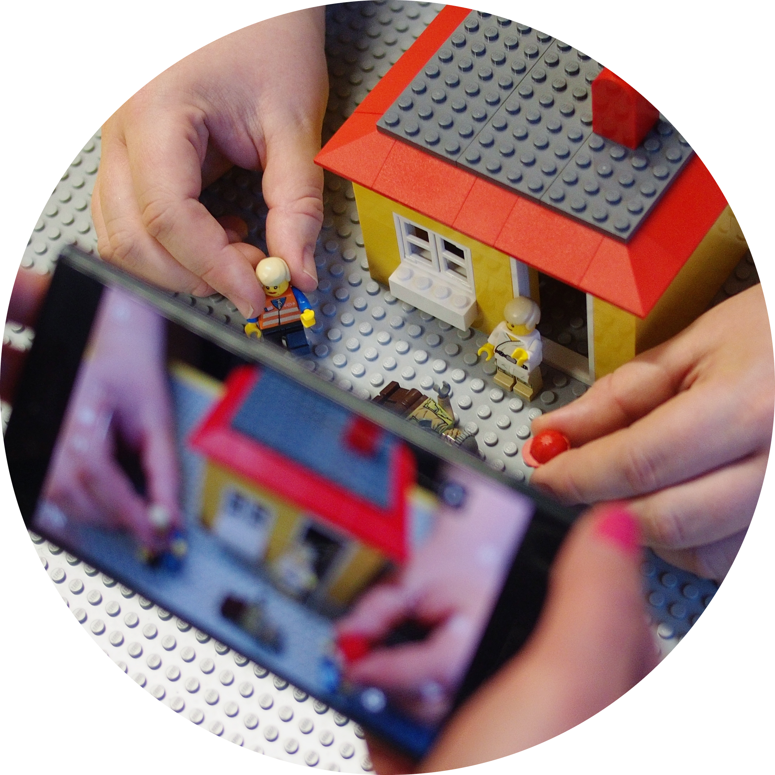




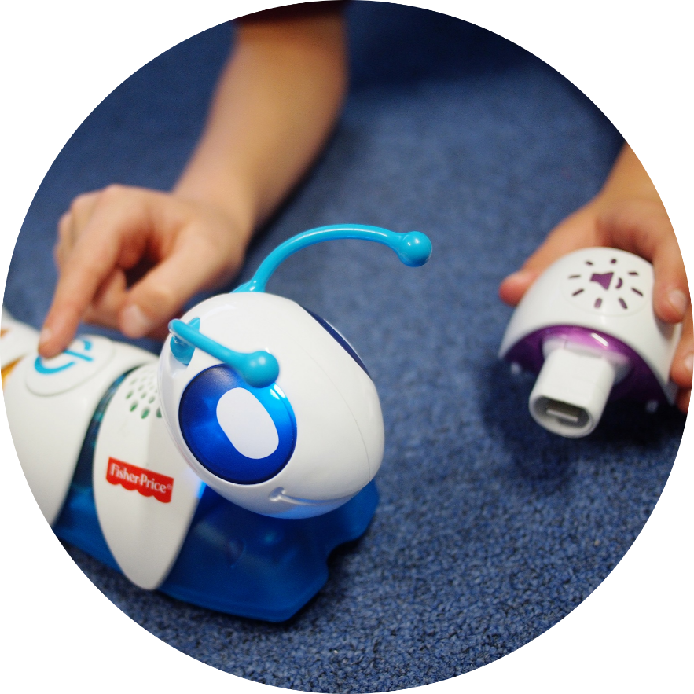
School Assembly
Insert pic
January 2024

Slide 2


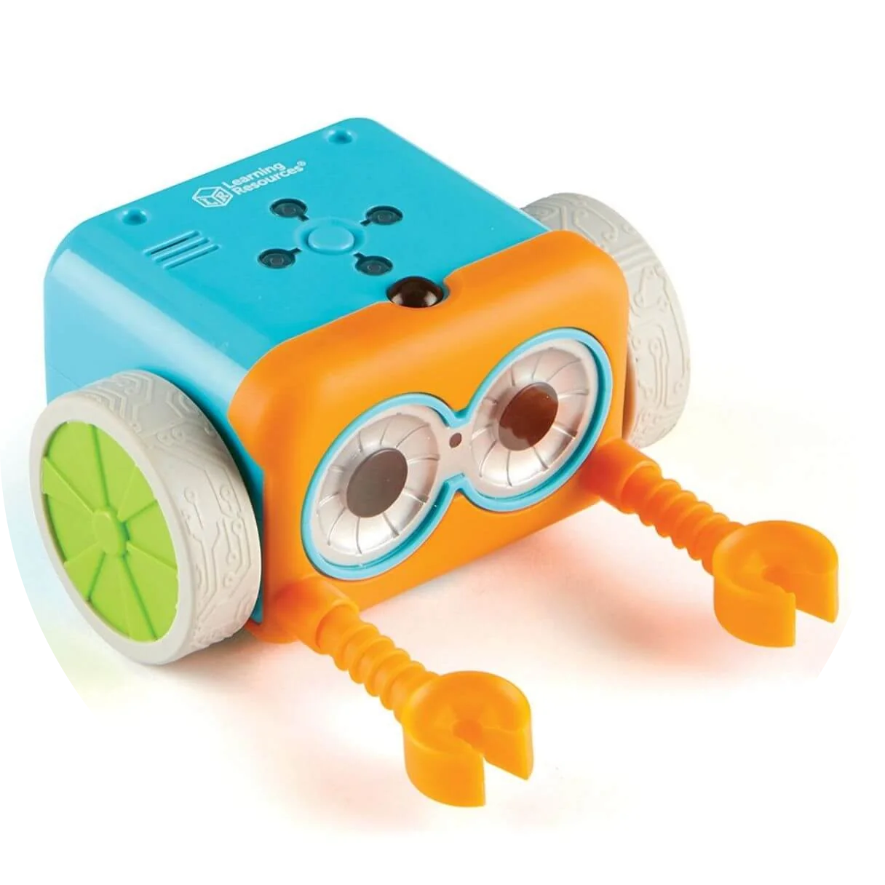

What is Digifest?
Throughout the whole of February there will be over 120 free events and activities taking place across the library service, for children aged four to 14.
Some events are one-off specials, such as a Lego Stop-Motion event, and the chance to use the Codeapillar or a Coding Critter to start learning about programming.
For 2024, we’ve got lots of snazzy new tech and new robots to meet, but not everything is about coding- there are great digital art and design opportunities too!

Slide 3
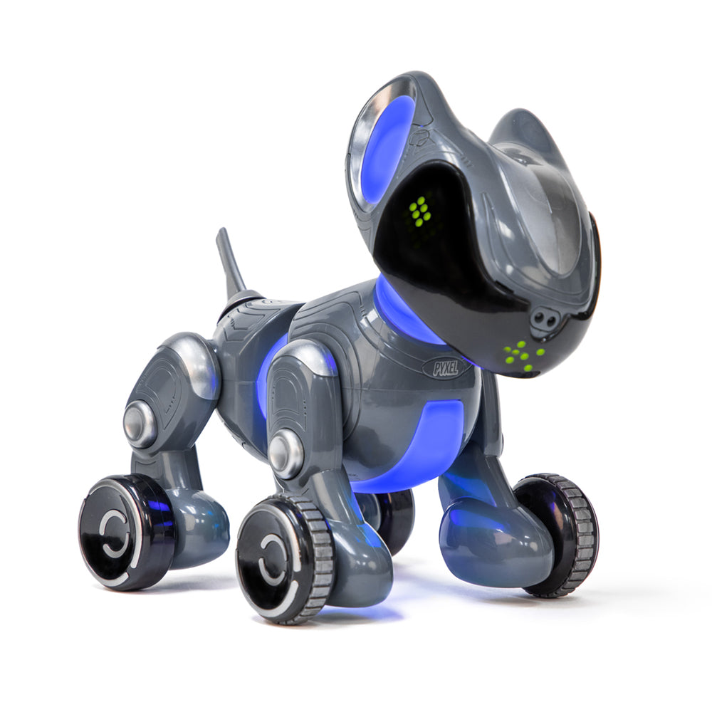
Where and when is Digifest?
Digifest is taking place in all Norfolk libraries- all 47 of them!
It’s happening for ALL of February- from 1st February onwards.

Slide 4
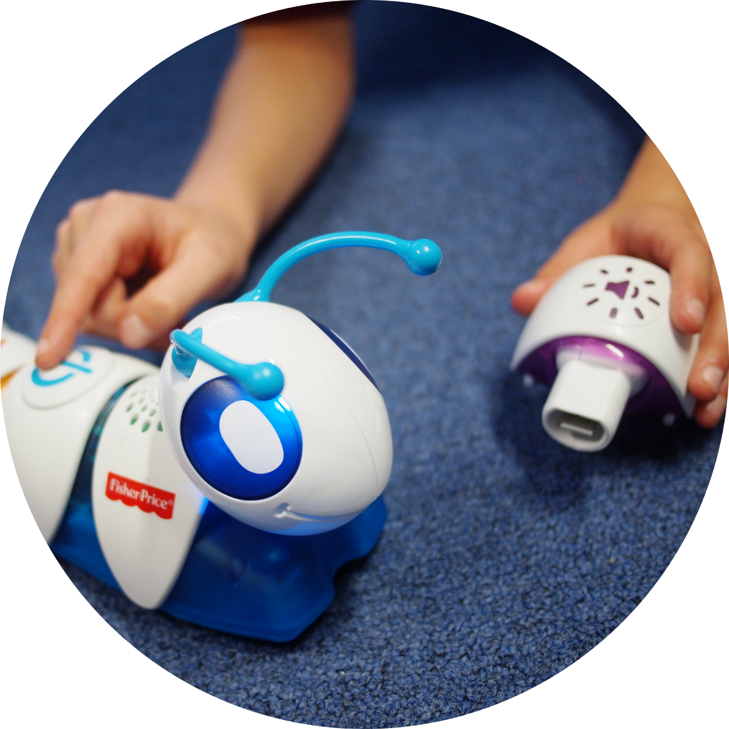
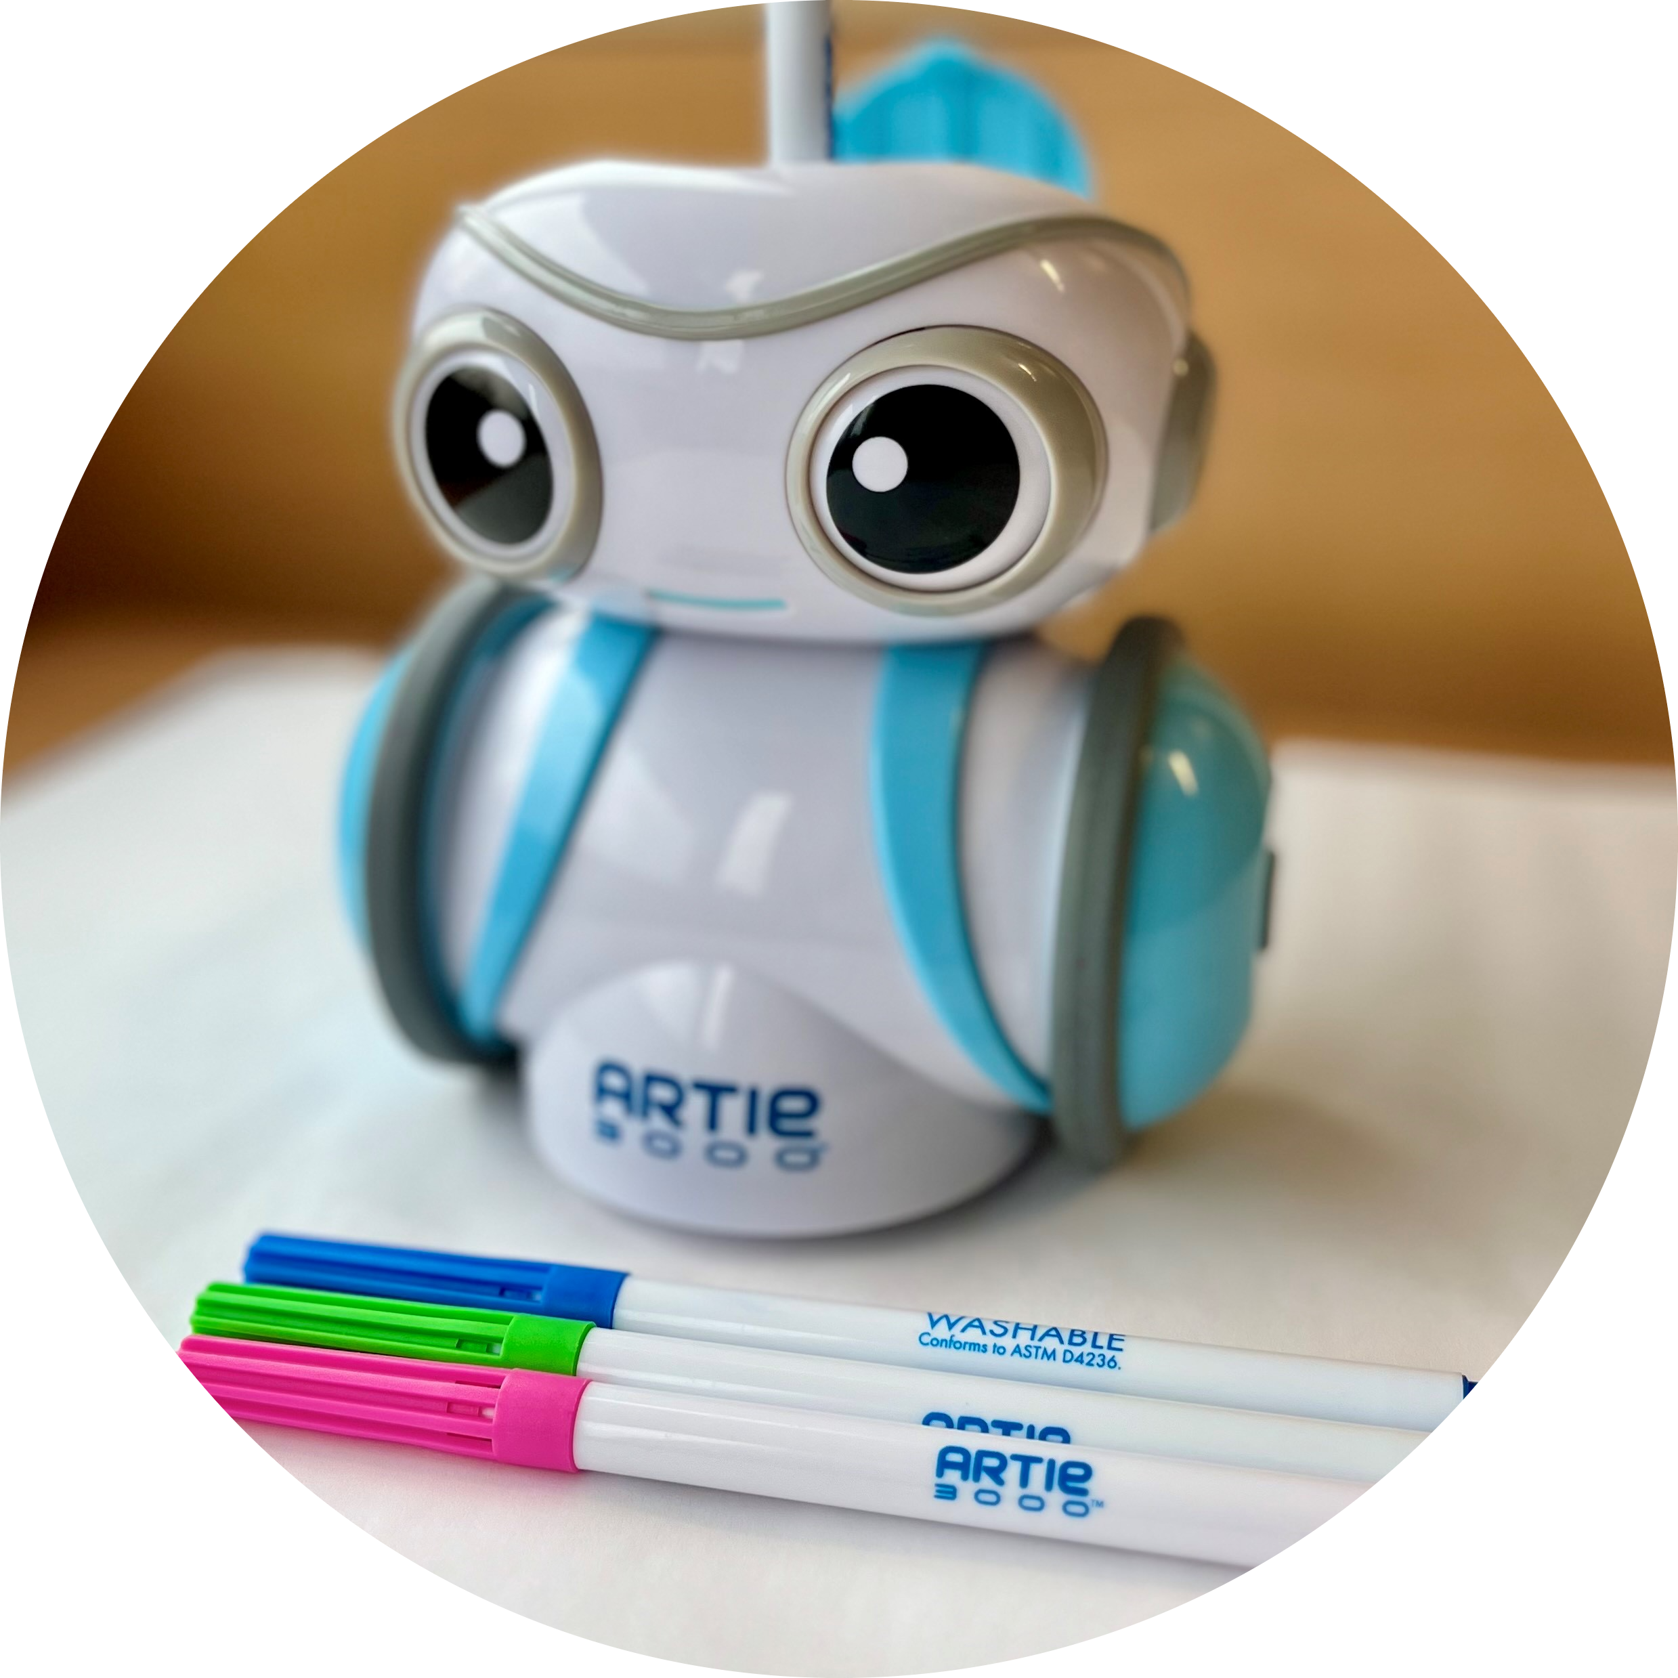
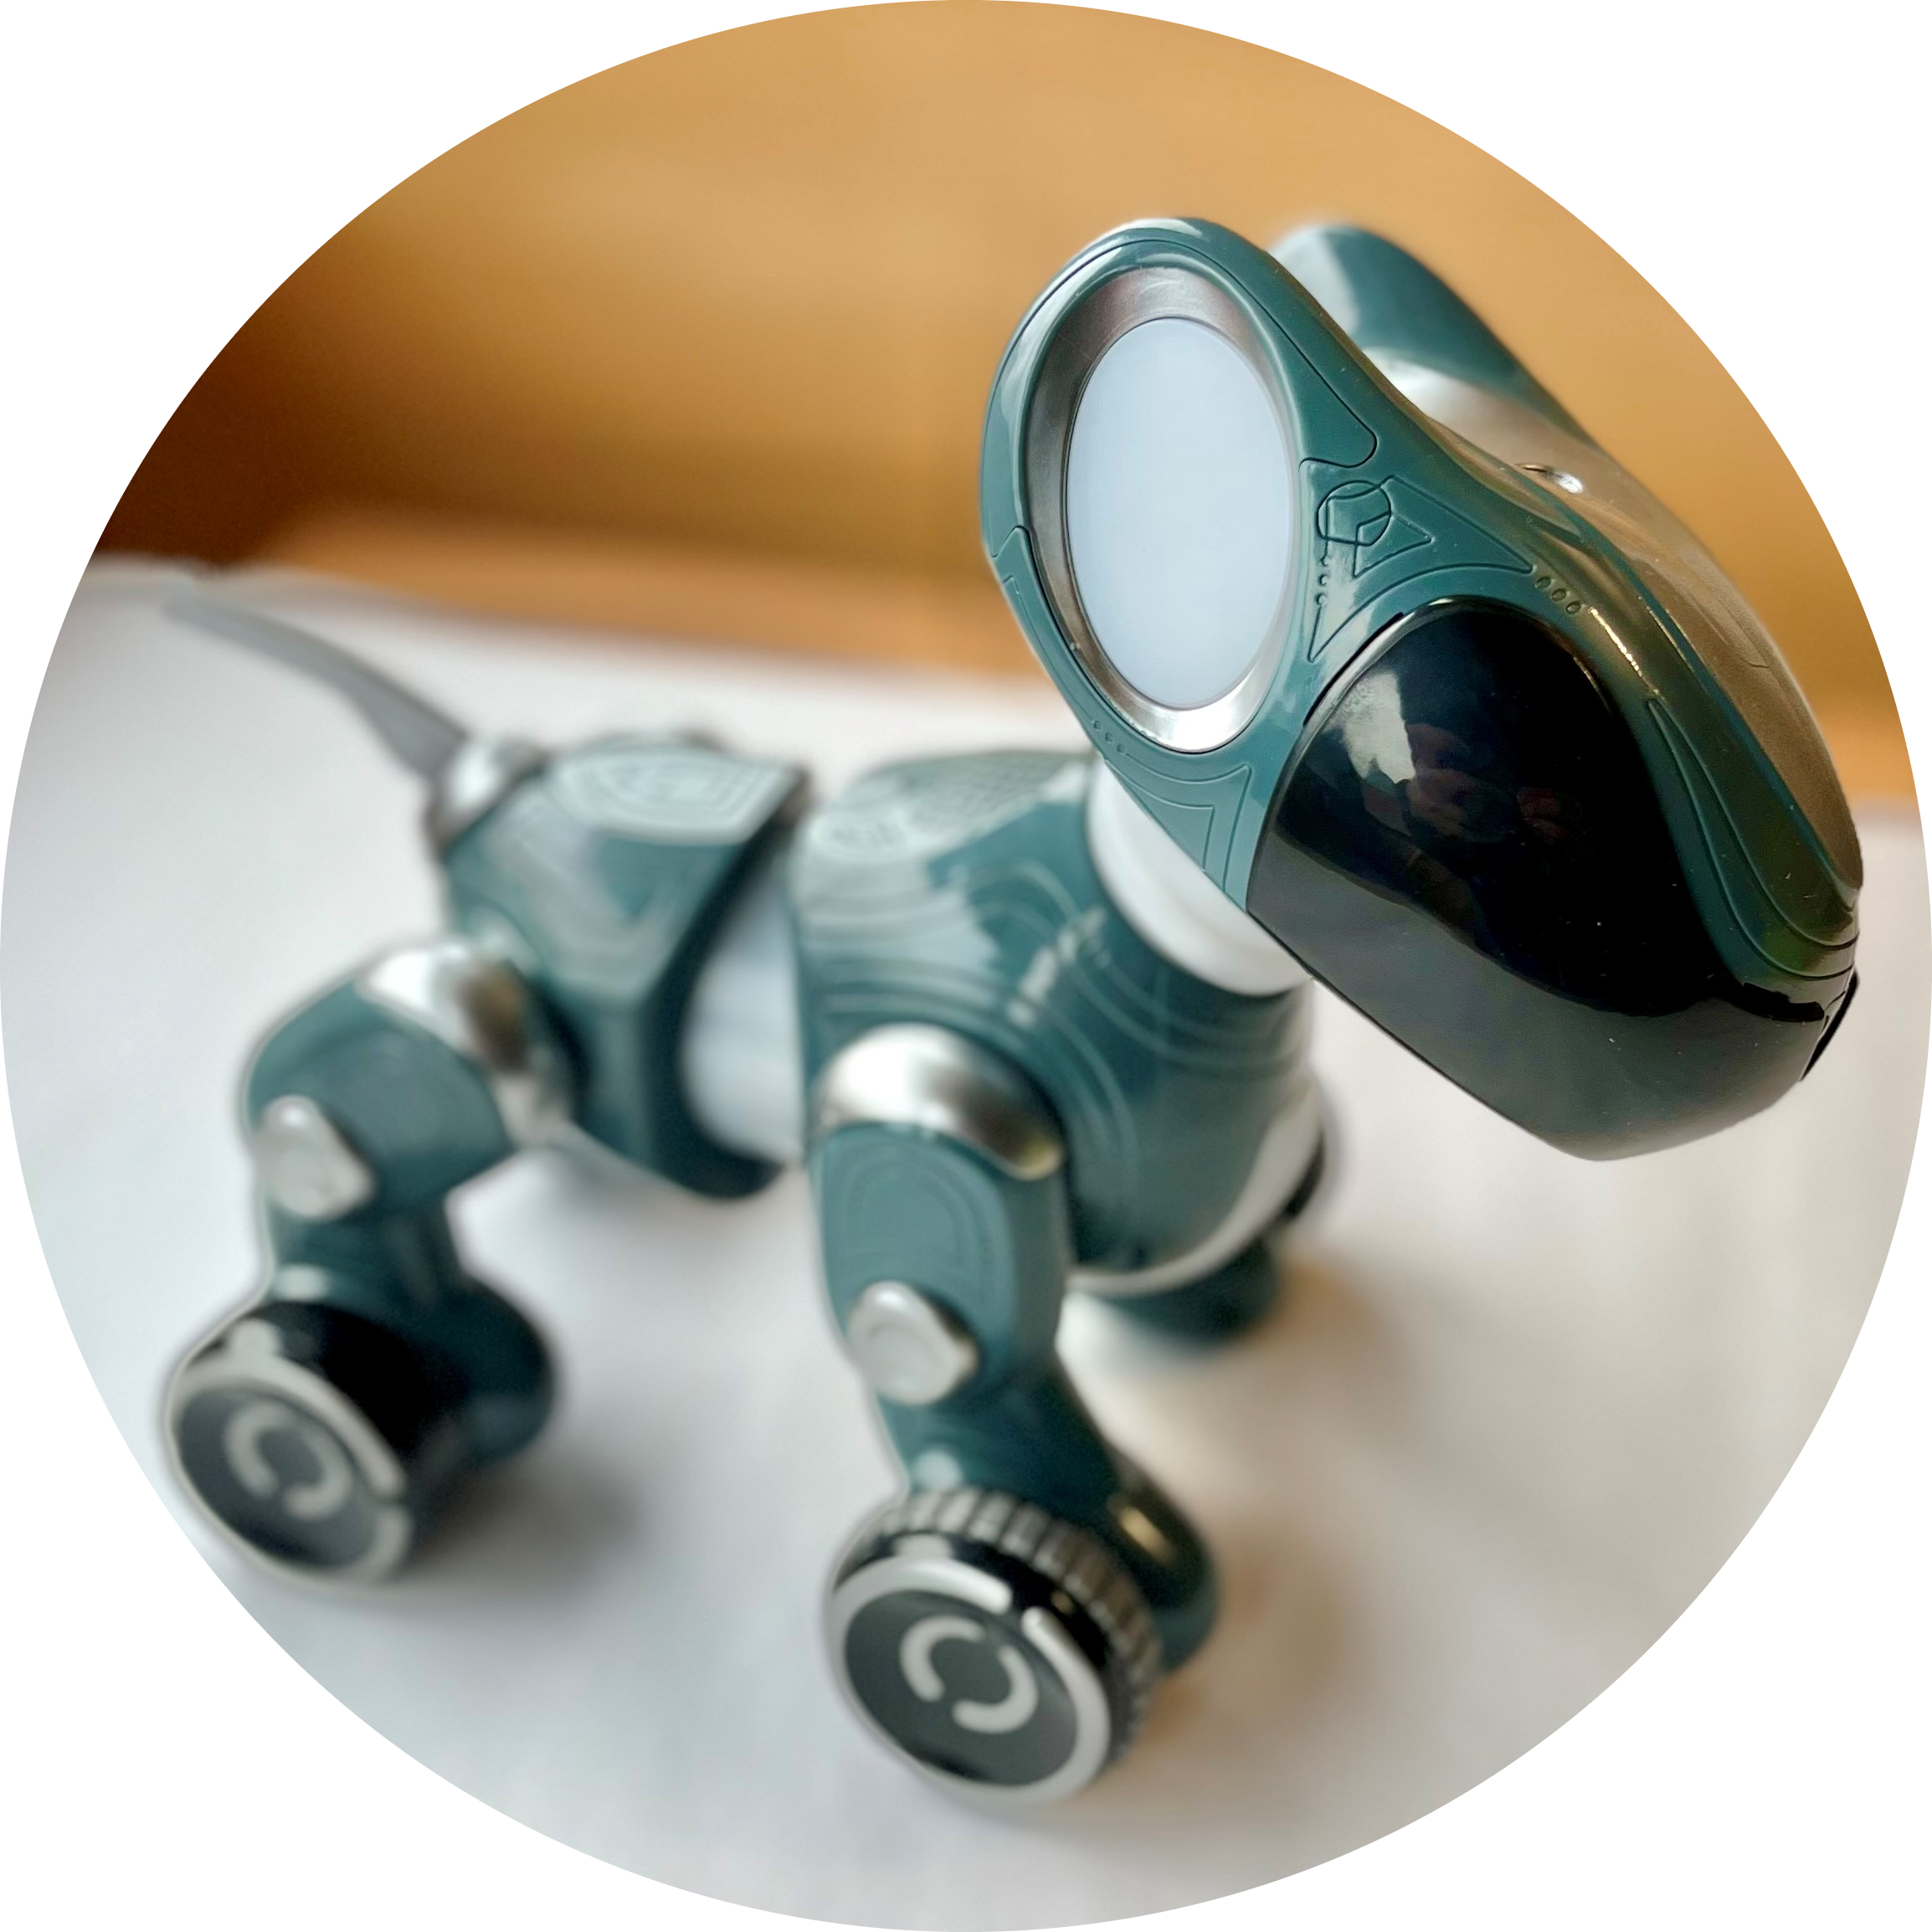
What Can You Do at Digifest?
Meet Robots!

Slide 5
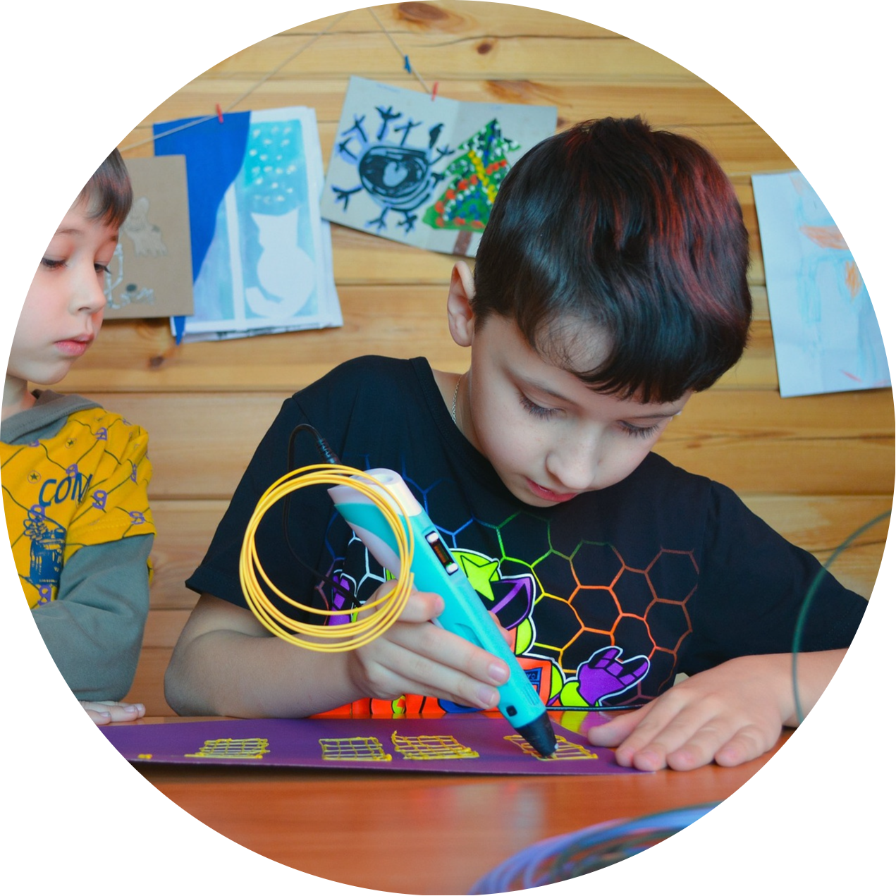
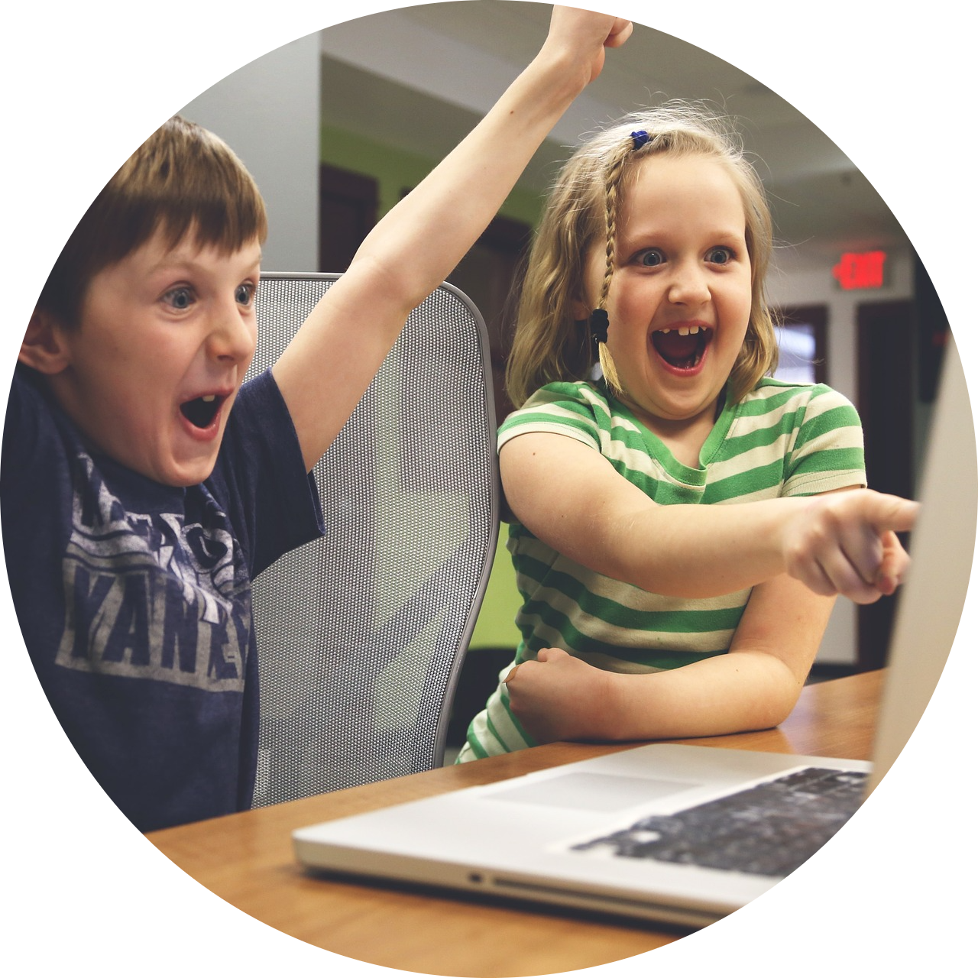
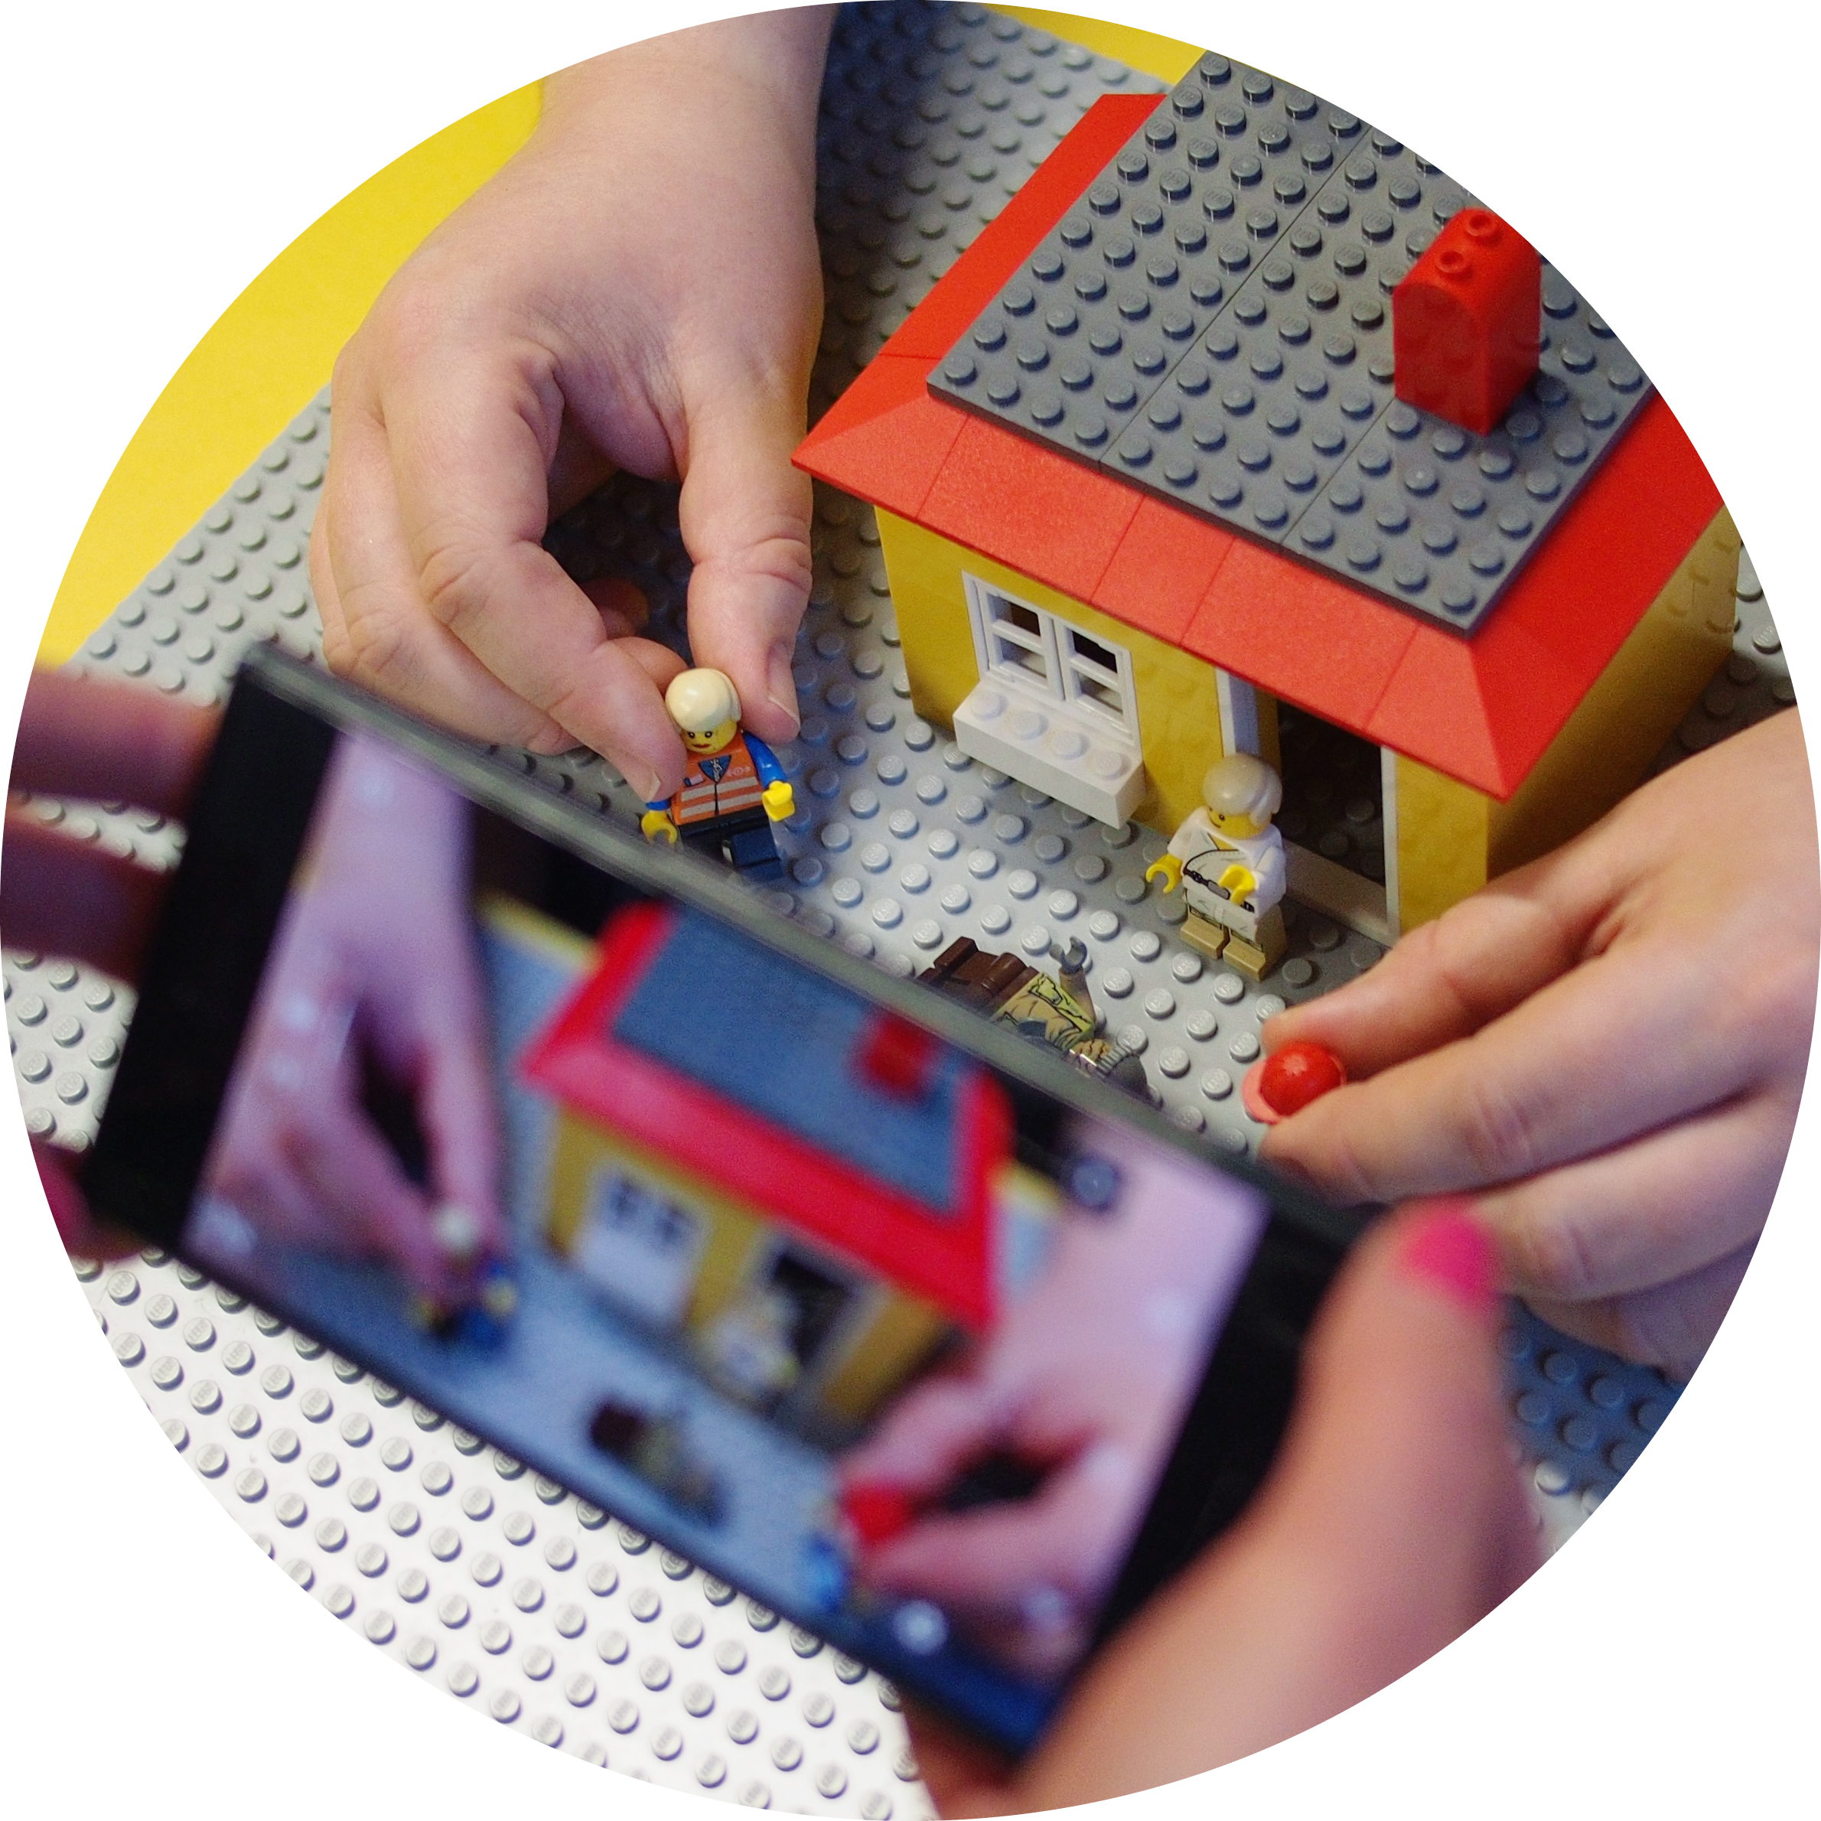
What Can You Do at Digifest?
Design & Create!

Slide 6
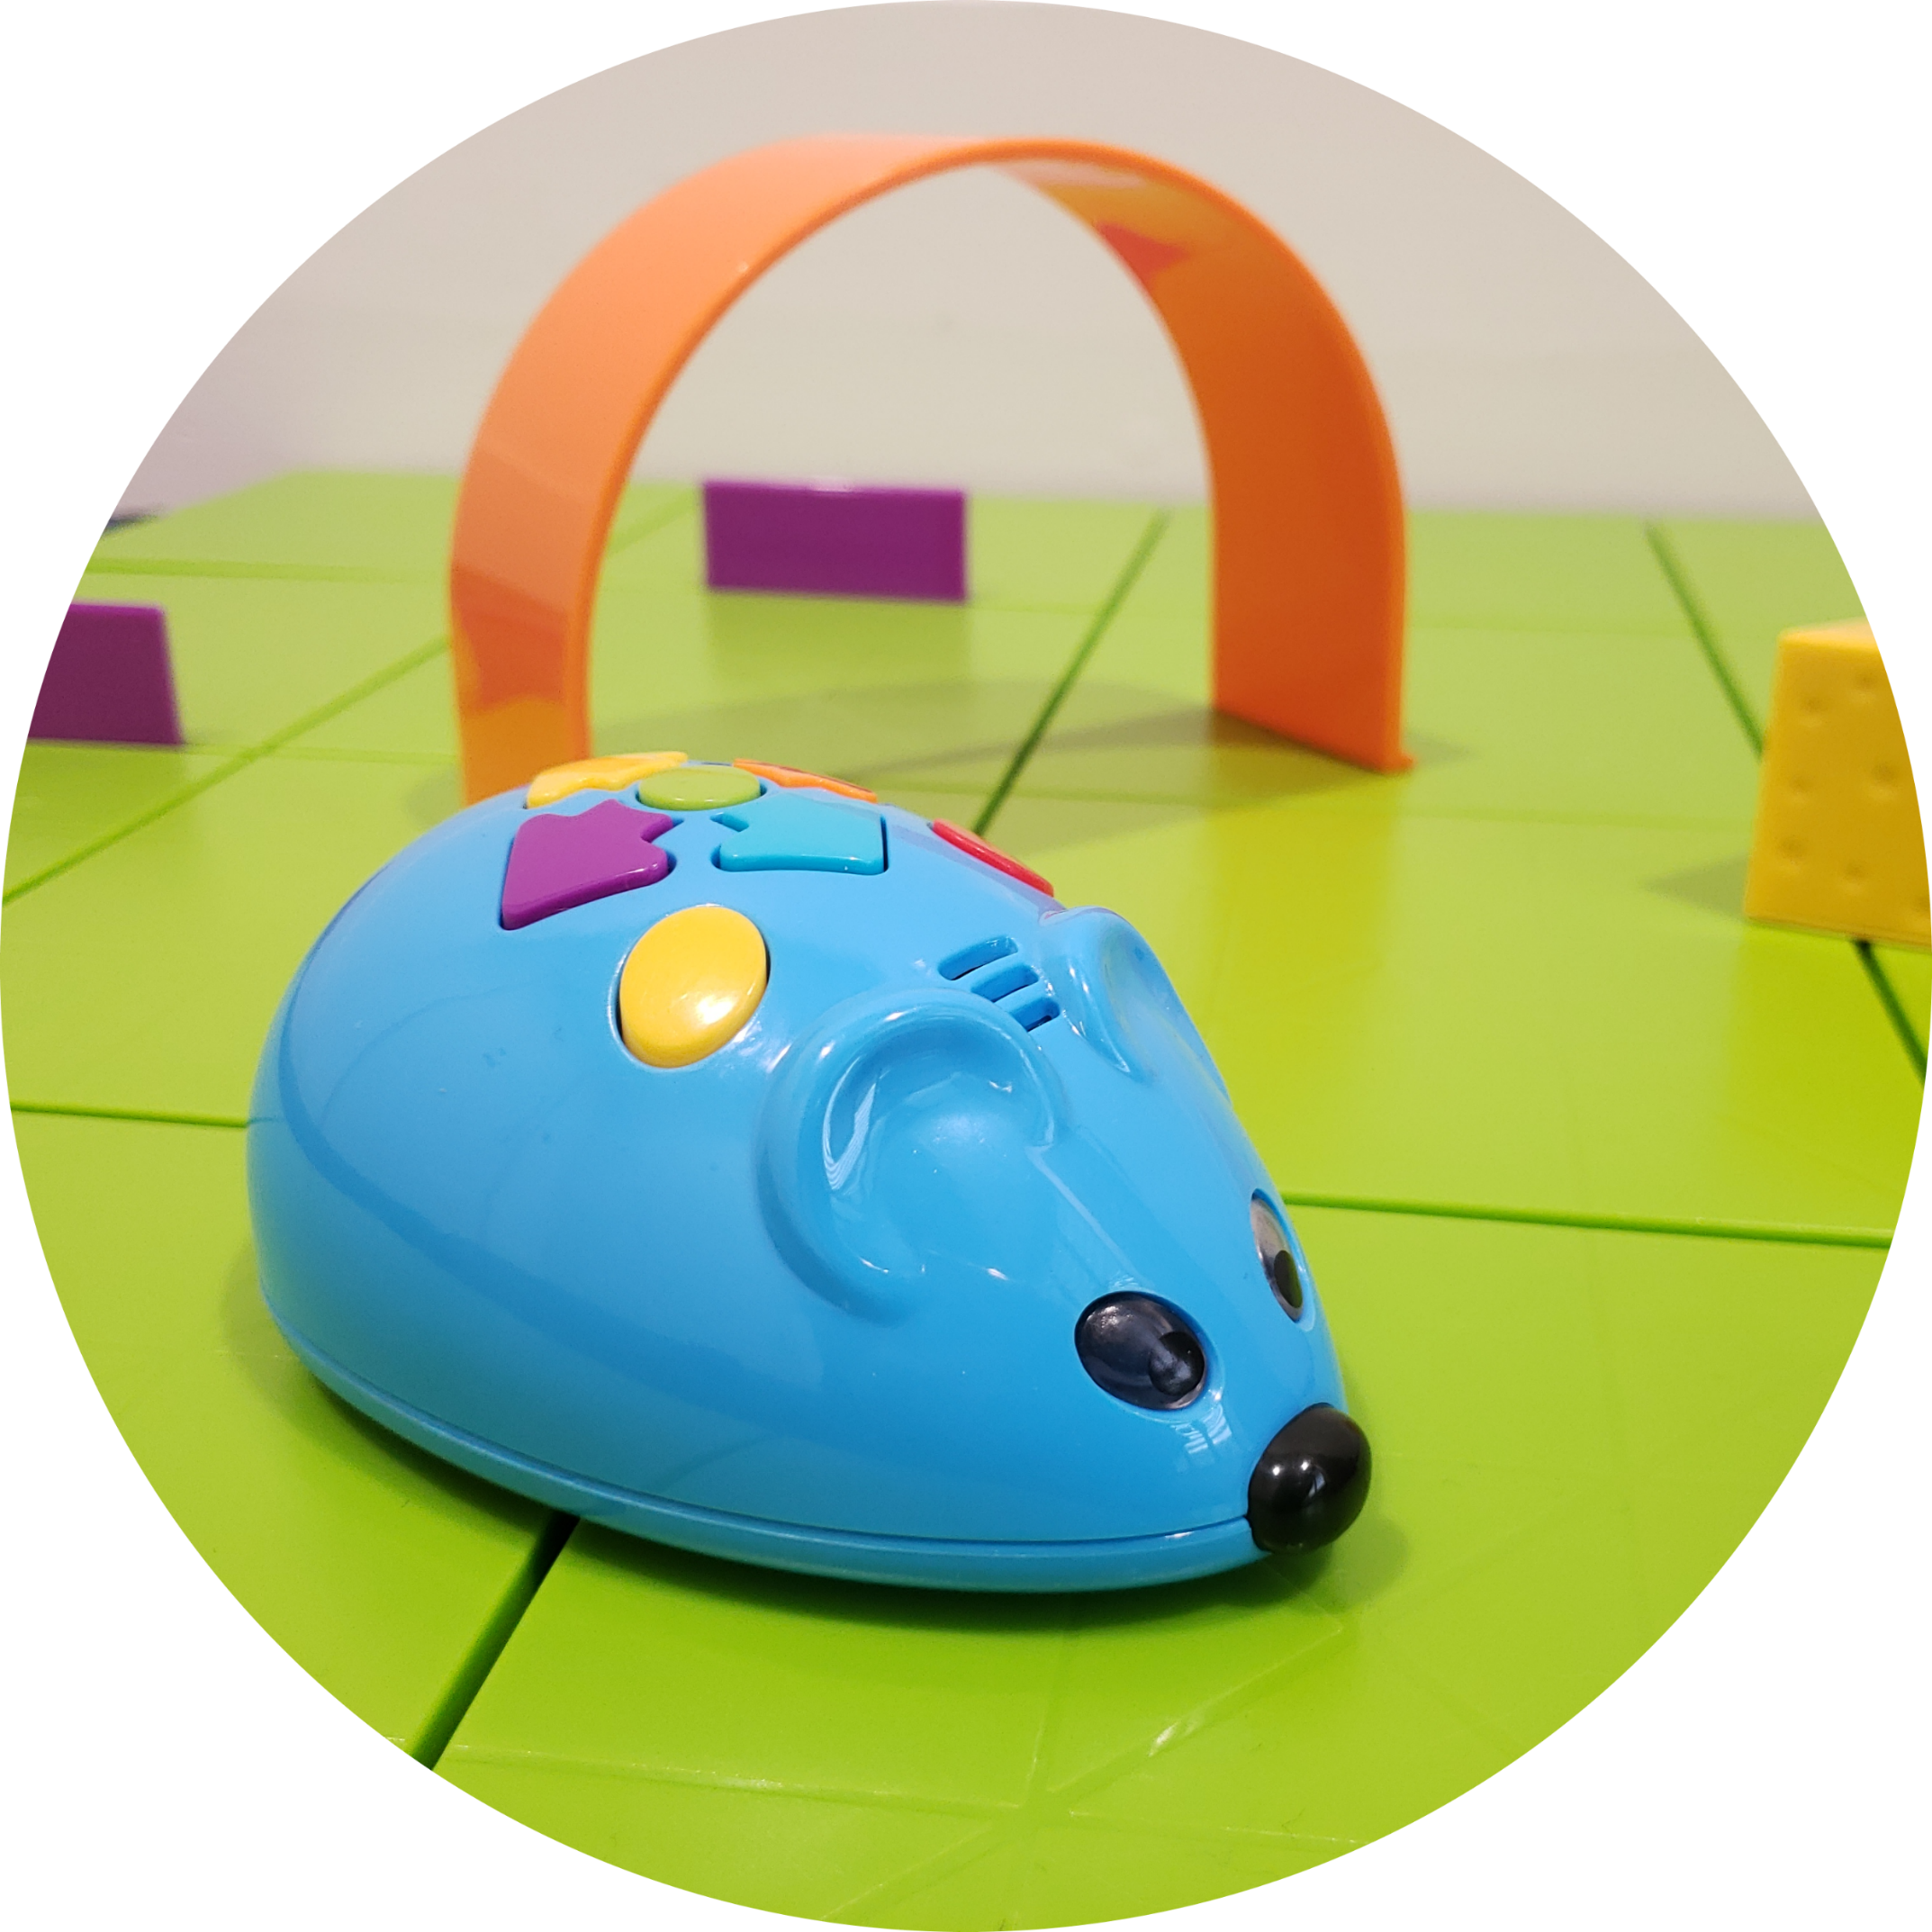
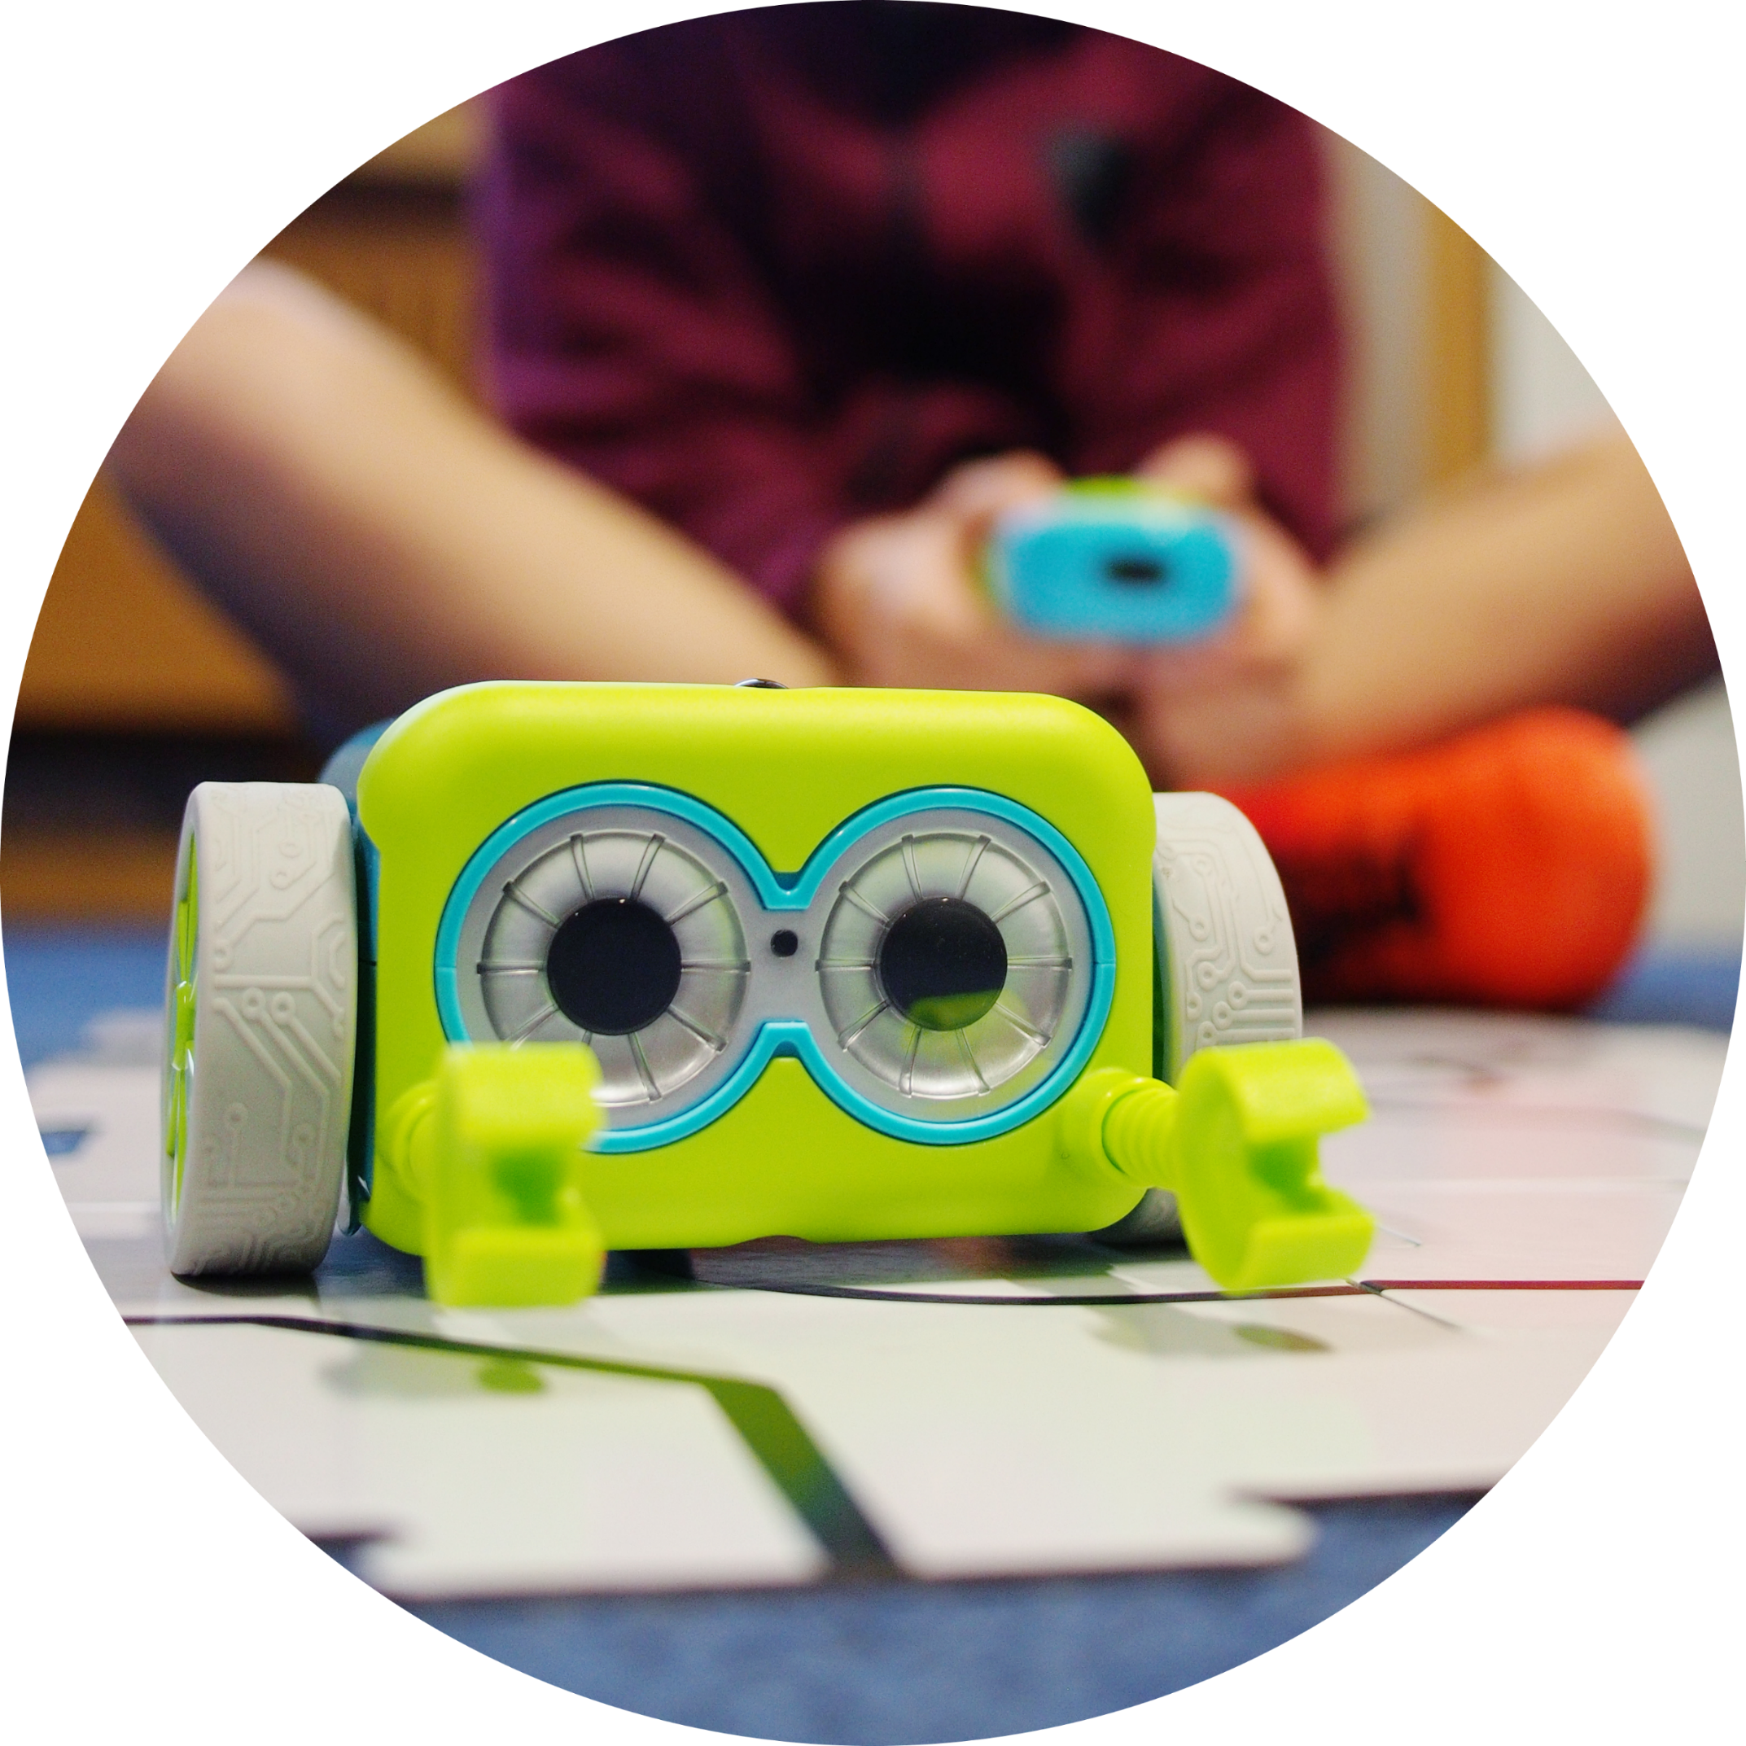
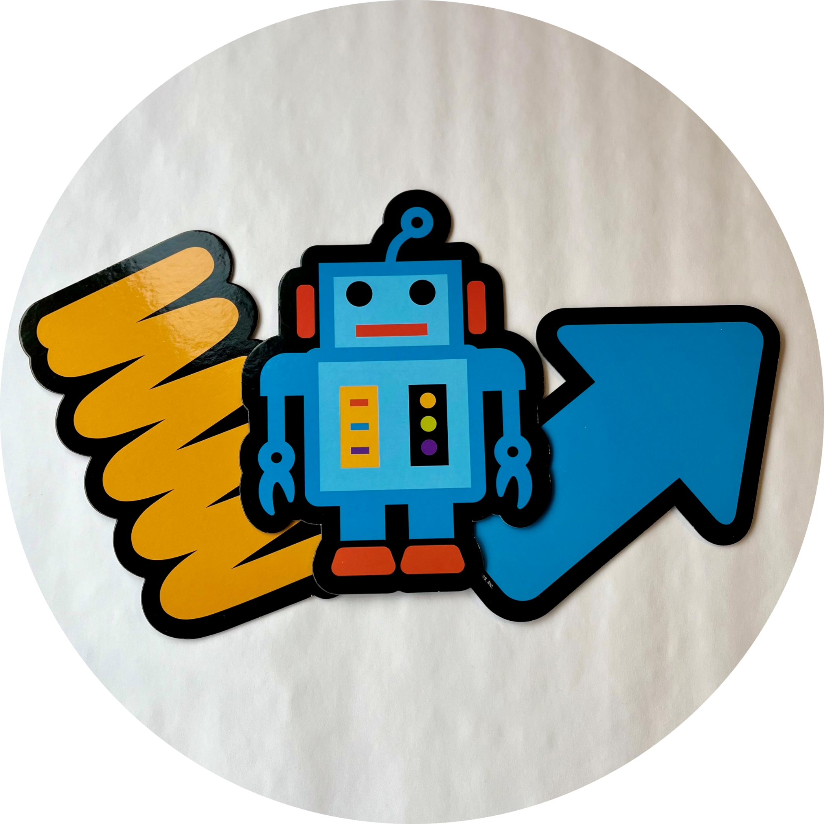
What Can You Do at Digifest?
Play Games!

Slide 7

What Digifest Looks Like...

Slide 8
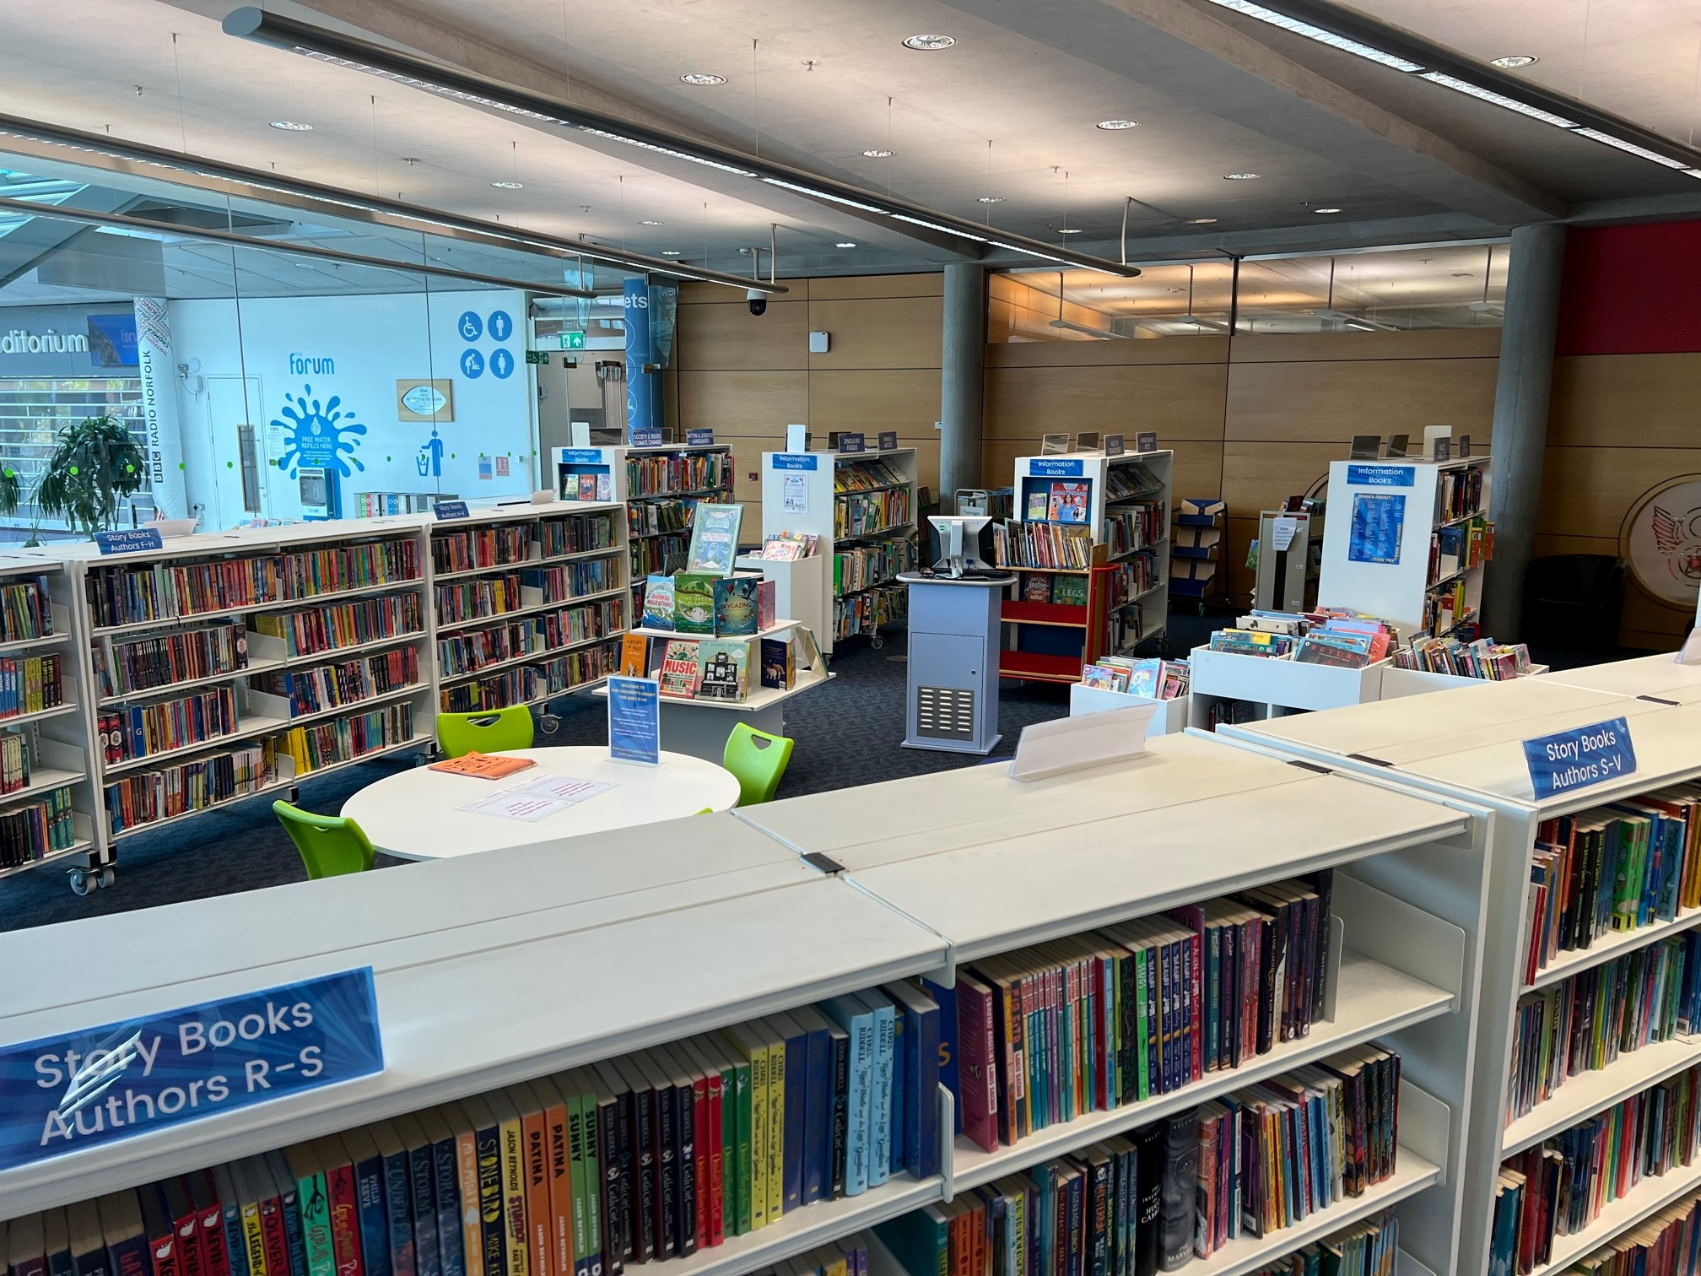
How Can YOU Get Involved?
Sign-up online
Visit your local library & speak to staff

